Slide 1
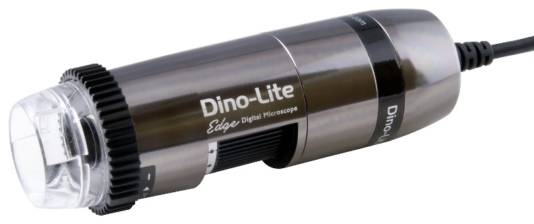
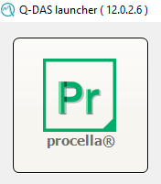

Slide 2
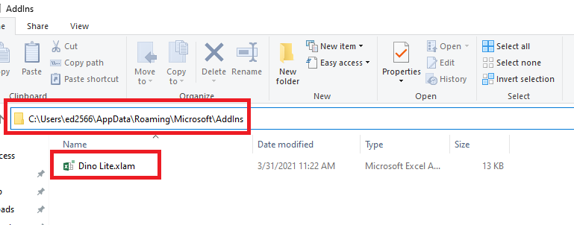
1
Put “Add-in” (Dino Lite) to your local directory

Slide 3
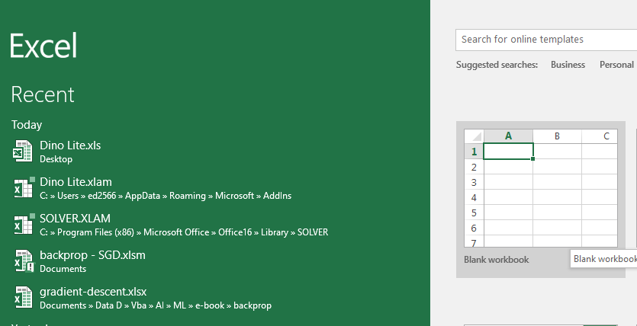
2
Open new Blank Workbook (excel)

Slide 4
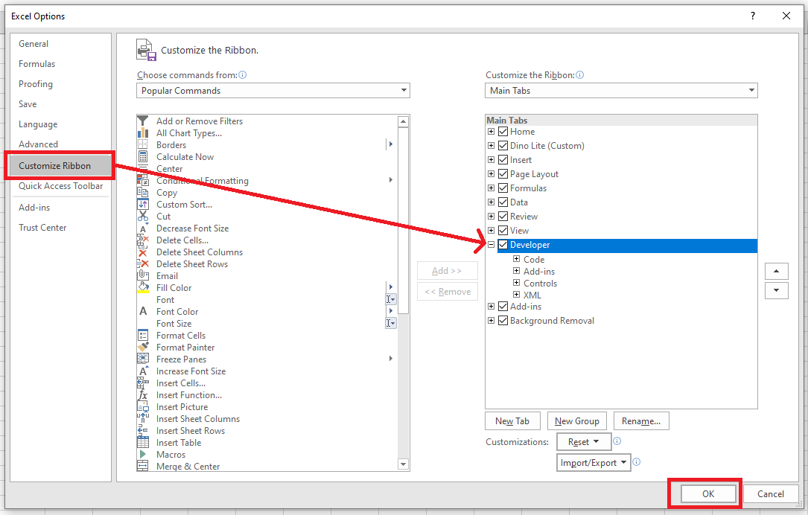
3
Activate “Developer” tab if not active

Slide 5
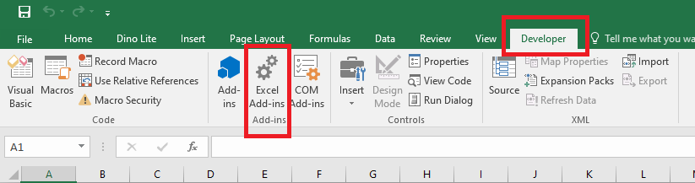
3b
Go to tab “Developer” >> “Excel Add-ins

Slide 6
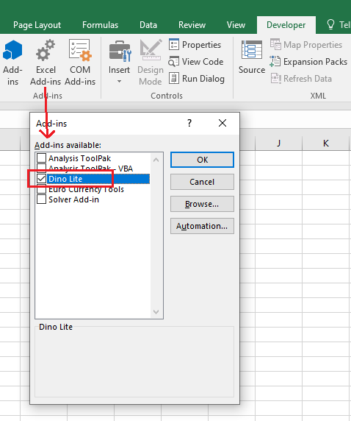
4
Activate “Dino Lite” Add-in

Slide 7
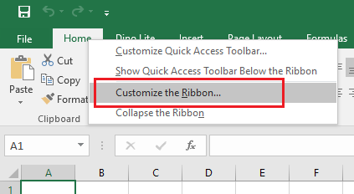
5
Right click on any tab and choose “Custom the Ribbon”

Slide 8
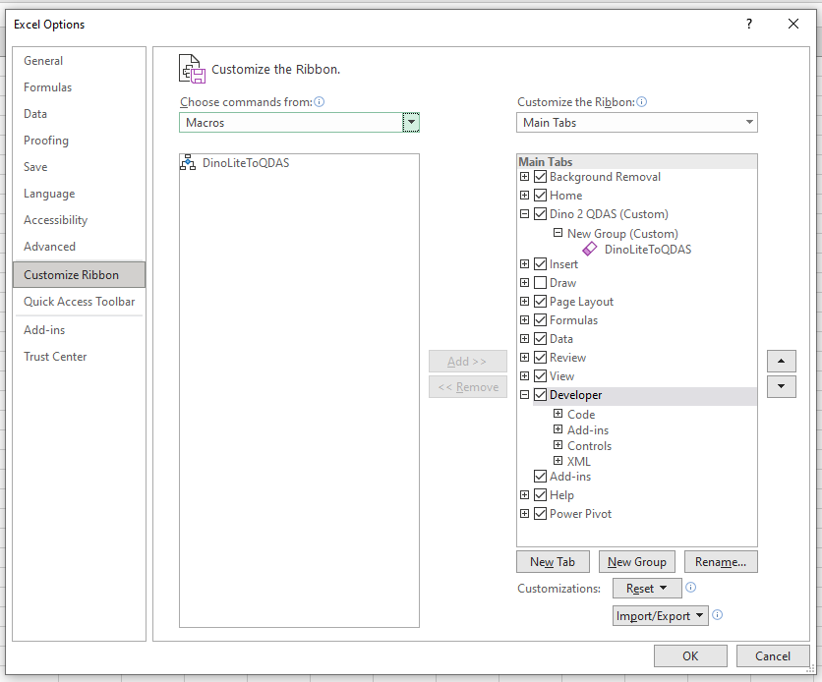
7
Create new tab then add “DinoLiteToQDAS” macro from list

Slide 9
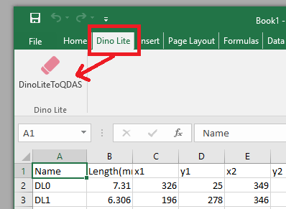
8
“Dino Lite” menu is added and ready to use!

Slide 10
How To Use !!!

Slide 11
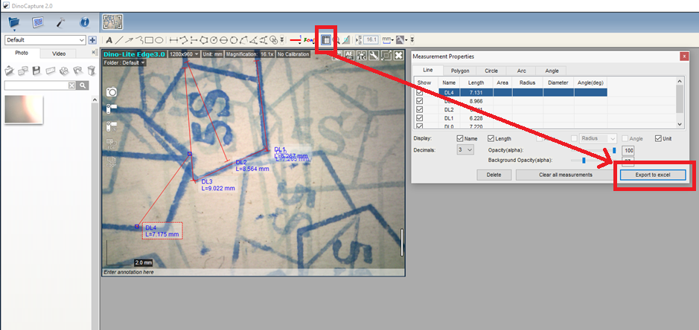
9
From “Dino Capture 2.0” click “measurements properties” then “Export to excel”

Slide 12
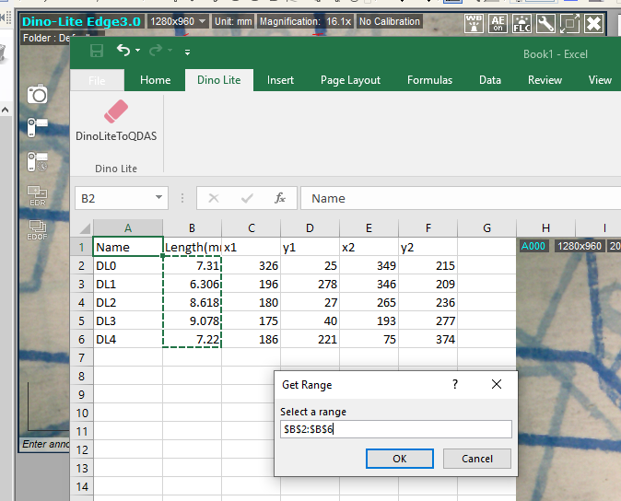
10
Select Range value to be transferred
Make sure Procella not in “Minimize” mode
Values will be transfer automatically to Procella once “OK” button pressed

